Slide 1
Week 13: Final Project Report
Amira Esmaeil

Slide 2
EDA

Slide 3
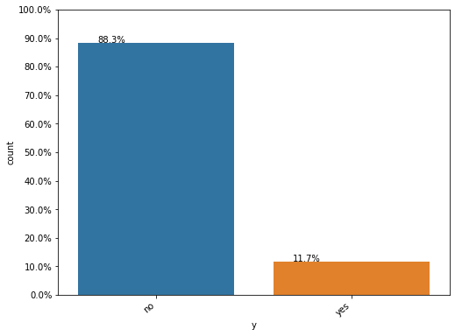
We can see from the above plot that the dataset in imbalanced, where the number of negative class is close to 8 times the number of positive class.

Slide 4
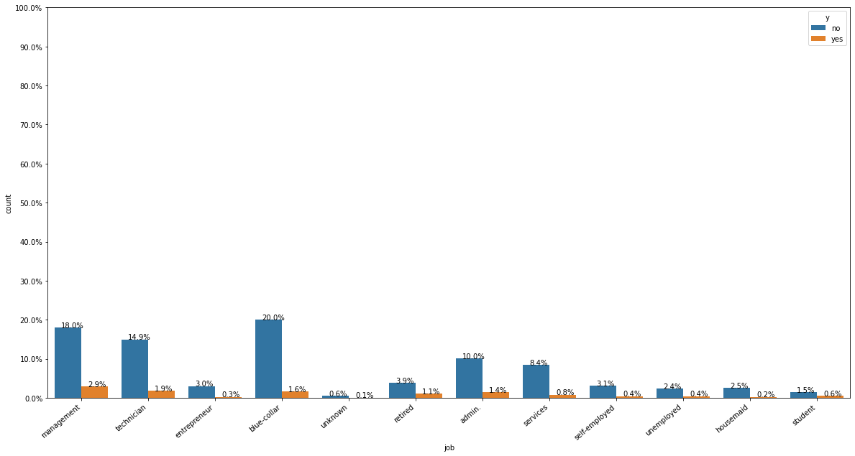
From the above plot, we can see that the customers who have a job of admin have the highest rate of subscribing a term deposit, but they are also the highest when it comes to not subscribing. This is simply because we have more customers working as admin than any other profession.

Slide 5
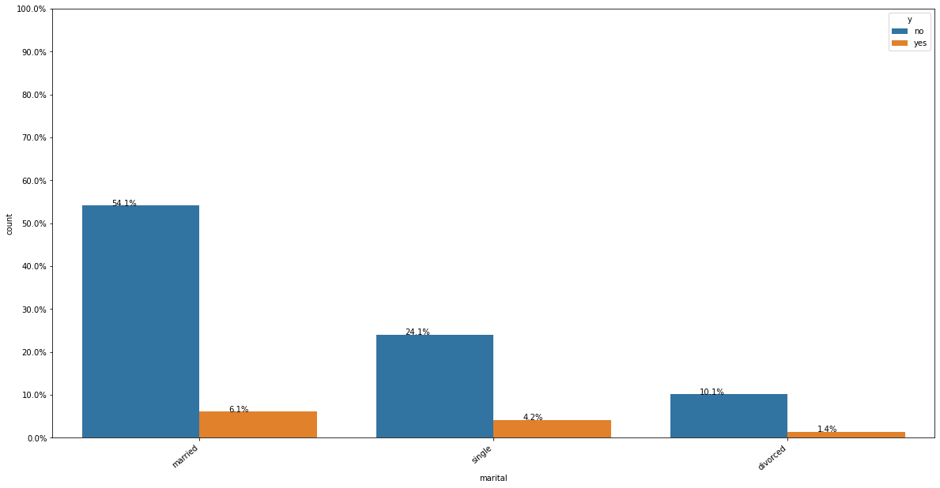
Majority of the customers are married. Followed by Single, divorced and unknown.

Slide 6
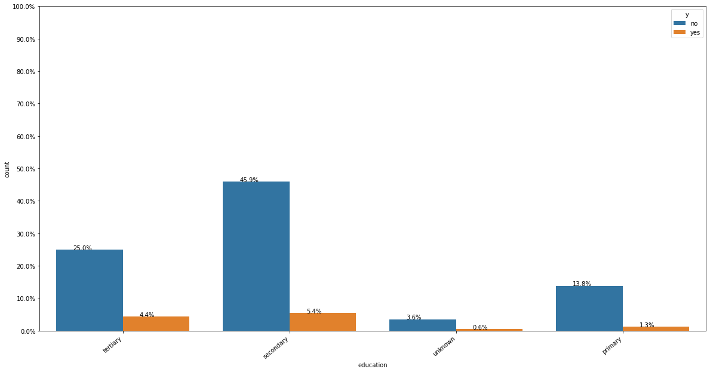
Customers with education is secondary is the highest with yes,so the campaigns should focus on those customers

Slide 7
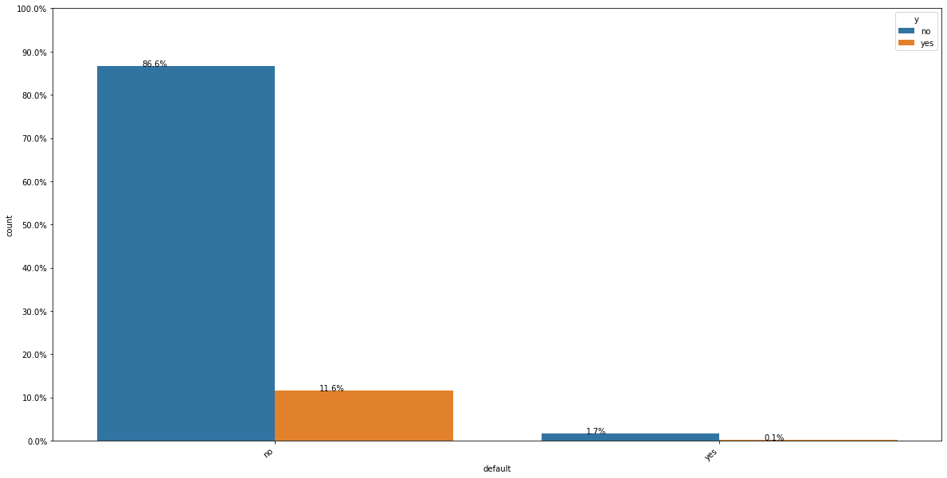
When customers has no credit in default, the customers is likely to buy our product. So the campaign should focus on those customers

Slide 8
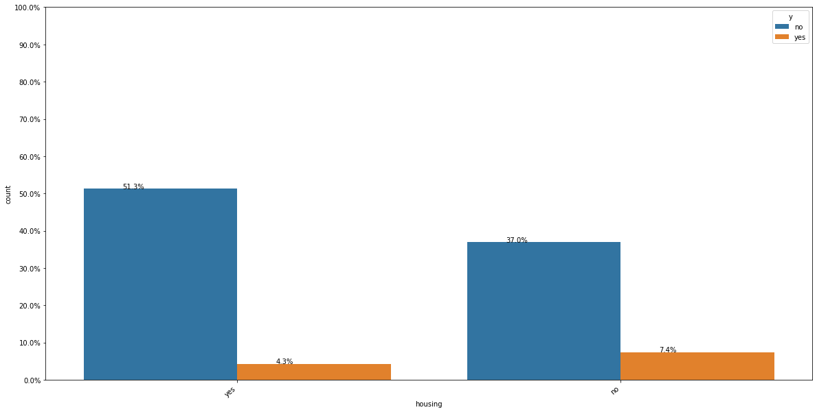
Customers with no housing loans are likely to buy our product

Slide 9
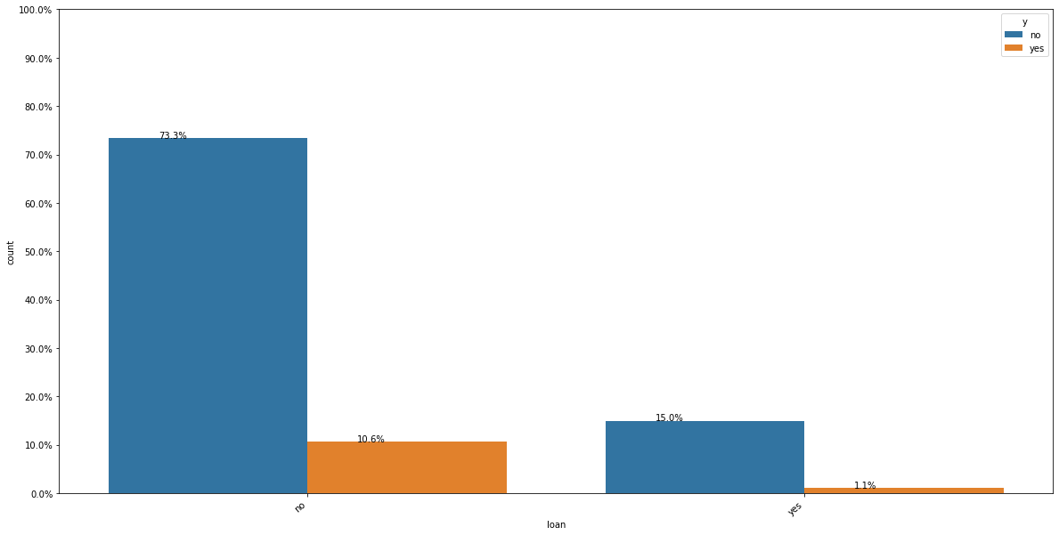
Majority of the customers have a housing loan.

Slide 10
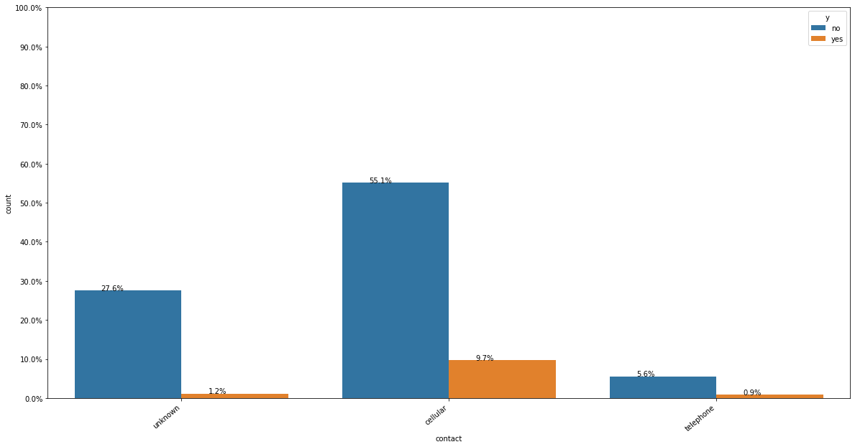
Customers with cellular phones are likely to buy our products

Slide 11
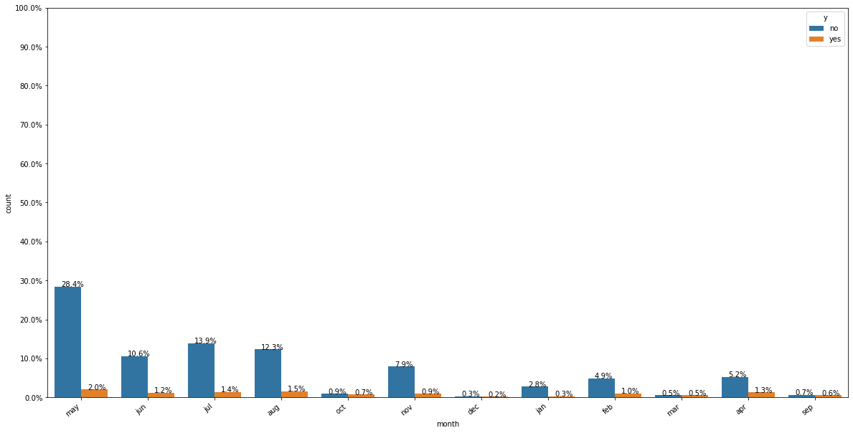
Month distribution for the customer profile

Slide 12
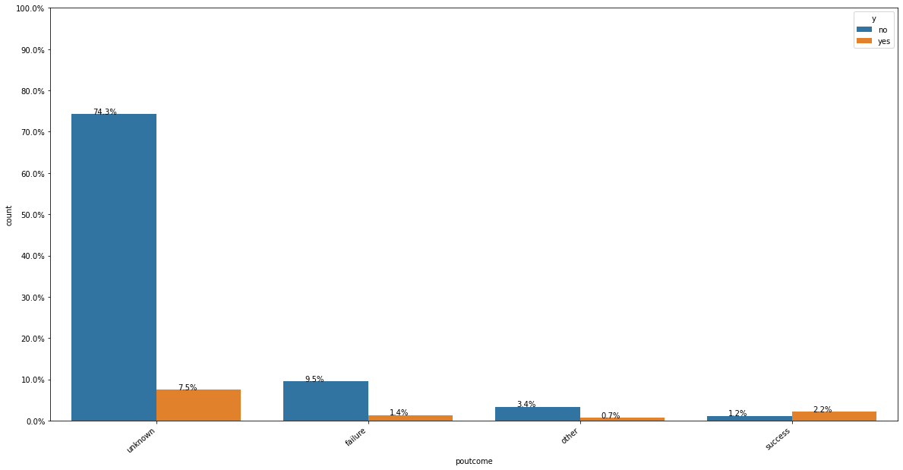
Customers with unknown outcome of the previous marketing campaign is the majority

Slide 13
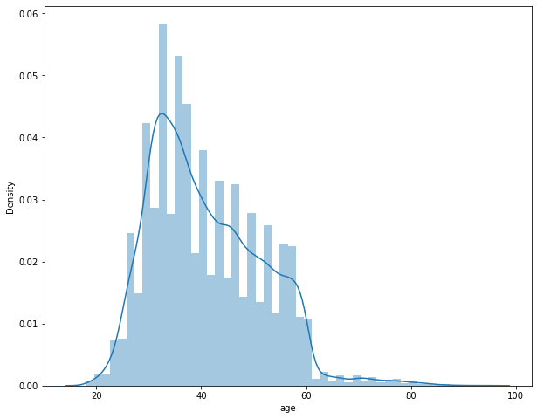
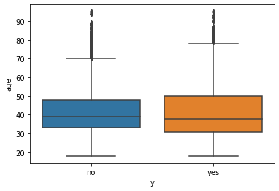
Both the customers that subscribed or didn’t subscribe a term deposit, has a median age of around 38–40. So, the campaign should focus on this age group

Slide 14
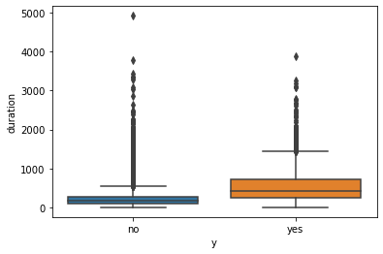
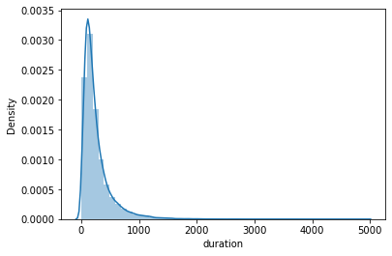
Age and duration are not necessarily a good indicator for which customer will subscribe and which customer will not.

Slide 15
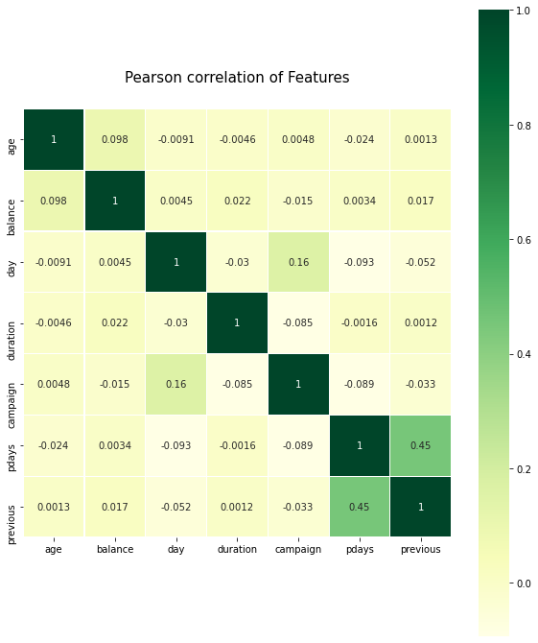
The highest correlation is between pdays (number of days that passed by after the client was last contacted from a previous campaign) and previous (number of contacts performed before this campaign and for this client)

Slide 16
Final Recommendations
The customers who have a job of admin have the highest rate of subscribing a term deposit, but they are also the highest when it comes to not subscribing. So the buiseness should send offers to them.
Majority of the customers are married. Followed by Single, divorced and unknown. The campaign should focus on the married customers
Customers with education is secondary is the highest with yes,so the campaigns should focus on those customers
When customers has no credit in default, the customers is likely to buy our product. So the campaign should focus on those customers
Customers with no housing loans are likely to buy our product
Majority of the customers have a housing loan.
Customers with cellular phones are likely to buy our products
Customers with unknown outcome of the previous marketing campaign is the majority
Both the customers that subscibed or didn’t subscribe a term deposit, has a median age of around 38–40. So, the campaign should focus on this age group
Age and duration are not necessarily a good indicator for which customer will subscribe and which customer will not.

Slide 17
Recommended Models
Logistic Regression
Linear SVM
Random Forest
XGBoost

Slide 18
Models

Slide 19
List of models
Logistic Regression
SVM
Random Forest
XGBoost

Slide 20
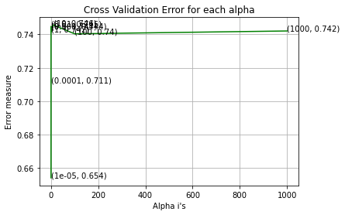
Logistic Regression
One Hot Encoding
For values of best alpha = 10 The train AUC is: 0.7381050303672549
For values of best alpha = 10 The cross validation AUC is: 0.7456636715383519
For values of best alpha = 10 The test AUC is: 0.7384804571338721
Response Coding
For values of best alpha = 10 The train AUC is: 0.7381050303672549
For values of best alpha = 10 The cross validation AUC is: 0.7456636715383519
For values of best alpha = 10 The test AUC is: 0.7384804571338721

Slide 21
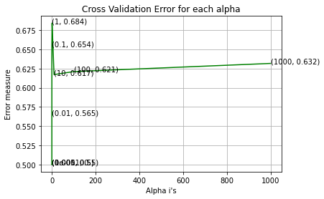
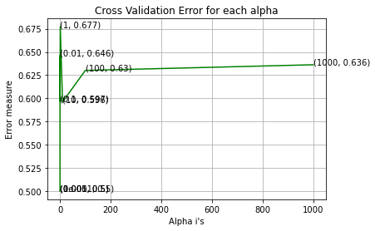
SVM
One Hot Encoding
For values of best alpha = 1 The train AUC is: 0.5620997406749615
For values of best alpha = 1 The cross validation AUC is: 0.5643176667261349
For values of best alpha = 1 The test AUC is: 0.5696721551215218
Response Coding
For values of best alpha = 1 The train AUC is: 0.5828714780764522
For values of best alpha = 1 The cross validation AUC is: 0.5855742990993849
For values of best alpha = 1 The test AUC is: 0.5871950196536586

Slide 22
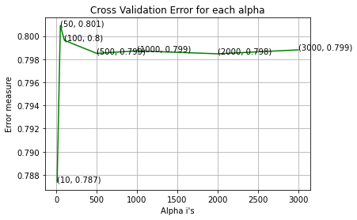
Random Forest
One Hot Encoding
For values of best alpha = 50 The train AUC is: 0.9999971226551445
For values of best alpha = 50 The cross validation AUC is: 0.8009095826171173
For values of best alpha = 50 The test AUC is: 0.7792199443159991
Response Coding
For values of best alpha = 50 The train AUC is: 0.9999971226551445
For values of best alpha = 50 The cross validation AUC is: 0.8009095826171173
For values of best alpha = 50 The test AUC is: 0.7792199443159991

Slide 23
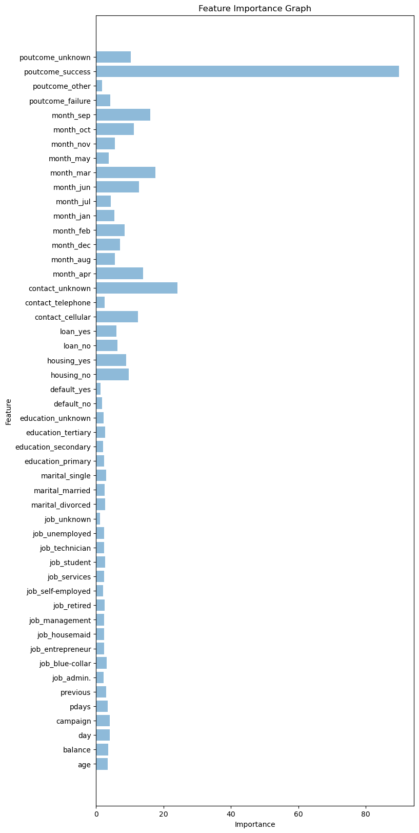
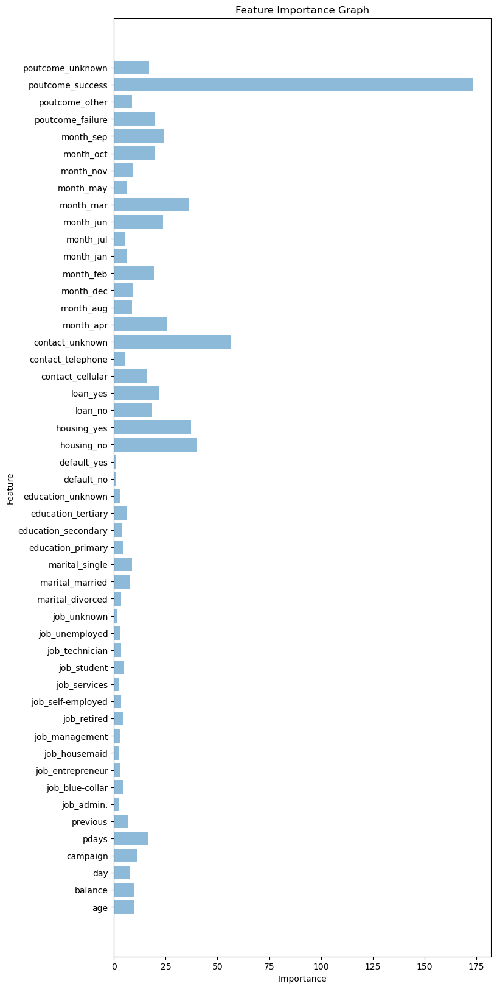
XGBoost
One Hot Encoding
For values of best alpha = 200 The train AUC is: 0.8644022752286666
For values of best alpha = 200 The test AUC is: 0.7902890640300494
Response Coding
For values of best alpha = 2000 The train AUC is: 0.8146844370252346
For values of best alpha = 2000 The test AUC is: 0.7897287844260755

Slide 24
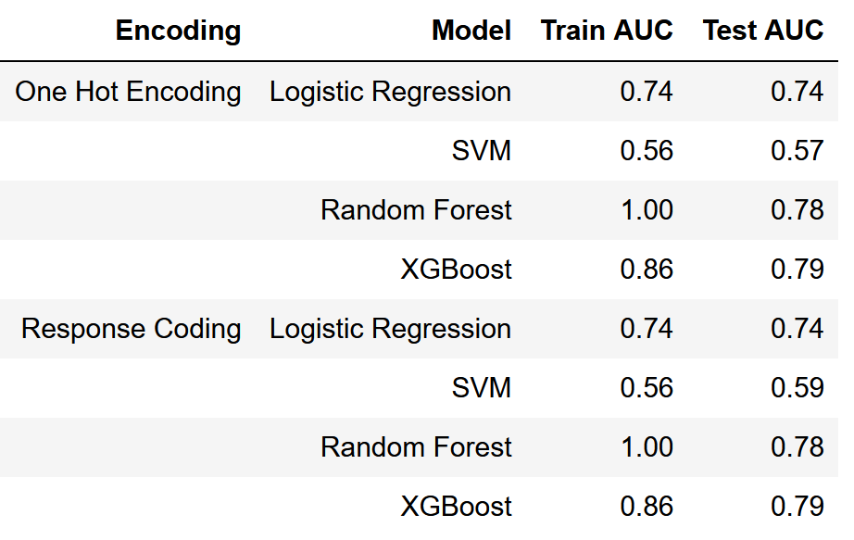
Models Summary

Slide 25
Best Model
Random Forest
XGBoost

